Slide 1
Deep Learning for Advanced Robot
Perception
RBE 595
Fall 2016
Autonomous Navigation of Drones in an Indoor Environment
Shanmuga perumal

Slide 2
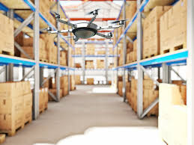
Idea
Use deep learning to develop a drone that could navigate an indoor environment autonomously ,avoiding obstacles.

Slide 3
Research Problem
Drones are becoming more popular by the day.
Not many that could navigate a GPS deprived environment
Indoor drones could serve several purposes
Security
Warehousing
Search and rescue
Personal assistant
etc.

Slide 4
Approach
End to End Learning
Map the sensor data directly to motion commands
Several teams trying to achieve this

